Slide 1
Increase Your Business with Arecont Vision
Megapixel IP Technology
Customer Webinar
16 January 2013
Notes:
Title Slide

Slide 2
Agenda
Welcome Mark Espenschied [MarCom Director]
Product Updates Brad Donaldson [Product Manager]
Partner Introduction Geoffrey Stoliker [Regional Sales Manager]
Theme: Remote Monitoring
Partner Profile: Westec Melissa Parsons [Director of Product Management]
Partner Profile: 3xLOGIC Brian Davis [Director of Sales]
Tech Tips & Tricks Ted Brahms [Director of Field Applications]
Close & Q&A

Slide 3
Arecont Vision Overview
Mark Espenschied
Director of Marketing Communications
Notes:
Title Slide

Slide 4
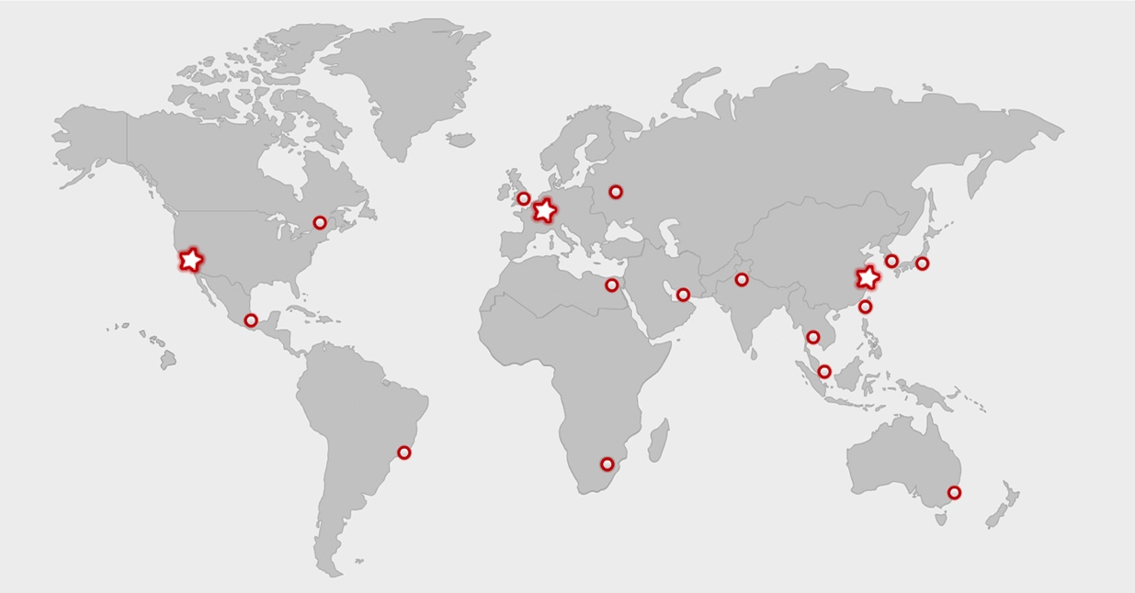
Company Profile
Arecont Vision protects your most valuable assets by providing the most efficient, highest resolution Multi-Megapixel IP Cameras for the Surveillance Industry.
Founded 2003
Global Resources and Infrastructure
Used by 50% of the Top Global Brands
8 consecutive years of strong revenue growth
Manufactured in the USA
Notes:
Company Profile Slide

Slide 5
Move to Multi-Megapixel is Accelerating
IP Camera Market
Multi-Megapixel Cameras
Standard Def. Cameras
Analog Camera Market
Manufacturer Value (Arecont Vision Estimates 5.12)
Notes:
IMS Research forecasts that 2013 will be the tipping point when world network video surveillance equipment sales overtake analogue video surveillance equipment sales.
IMS Research recently published a report, "IP Trends in Security – A Survey of Systems Integrators and Installers." The report also found that currently 80 per cent of North American systems integrators and installers purchase IP-based video surveillance equipment from IT distributors, and that this was expected to increase to 90 per cent of systems integrators and installers in three years’ time.

Slide 6
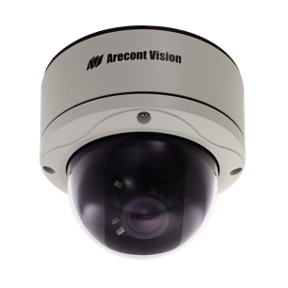
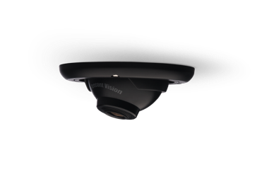
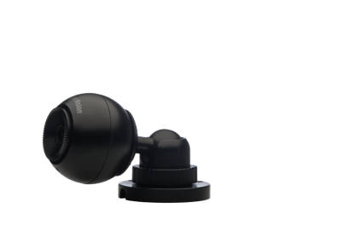
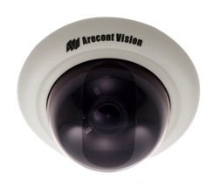
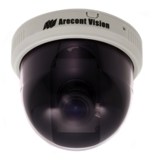
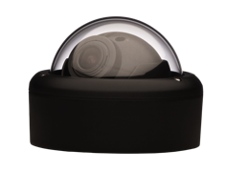
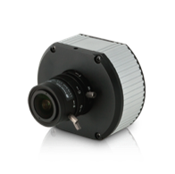
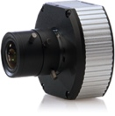
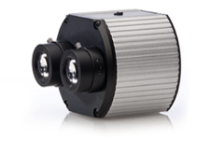
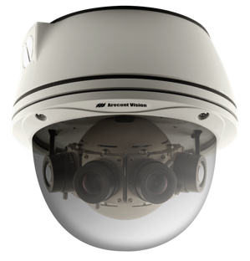
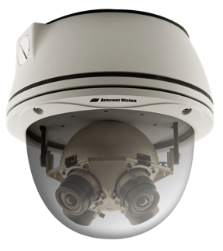
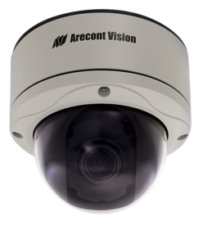
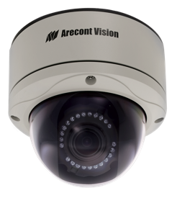
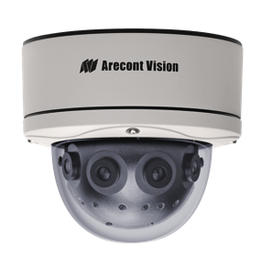
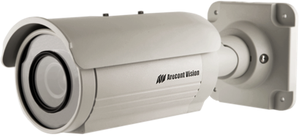
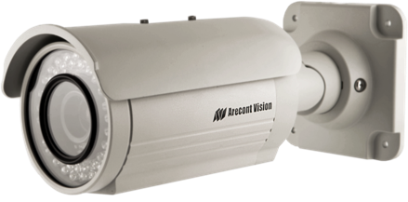
Most Complete Product Line
Wall Mount
Dome
Recessed Dome
Compact
Compact WDR
Dual Sensor
D4F
D4S
D4SO
MegaBall™
MegaVideo®
MegaVideo® D4 Series
Standard
IR Version
WDR 180º Panoramic
(Coming Soon)
180º Panoramic
360º Panoramic
Standard
IR Version
MegaDome® 2
SurroundVideo®
MegaView®

Slide 7
Pixel per $ – The ROI of Megapixel
Class | Resolution | Pixels | AV Pix / $1
10MP | 3648x2752 | 10,039,296 | 18,438
5MP | 2592x1944 | 5,038,848 | 10,179
3MP | 2048x1536 | 3,145,728 | 7,149
HDTV 1080p | 1920x1080 | 2,073,000 | 5,891
1.3MP | 1280x1024 | 1,310,000 | 4,039
HDTV 720p | 1280x720 | 921,600 | 2,836
VGA | 640x480 | 307,200 | 1,536
12x
Lower Price per Pixel than VGA

Slide 8
When it Comes to Megapixels, What Matters Most
PERFORMANCE
INNOVATION
ROI
QUALITY
CUSTOMER SERVICE

Slide 9
It’s Easy to Work with Us
Comprehensive Partner Program to Address Your Unique Needs
Channel Partner Certification Program
A&E Partner Program
Distributor Success Program
Technology Partner Program
Reseller Partner Program
Notes:
Whether you are looking for a VMS to compliment your system, a distributor to buy from, an integrator to install them or you simply want to learn more about megapixel technology, Arecont Vision has the right partner program for you. Being the industry leader in megapixel technology, we have the pleasure of teaming with the best partners in the industry.

Slide 10
Want to Learn More?
AVSales@ArecontVision.com
818.937.0700
www.ArecontVision.com
Type your question or request into the GoToWebinar chat box

Slide 11
New Product Update
Brad Donaldson
Product Manager
Notes:
Title Slide

Slide 12
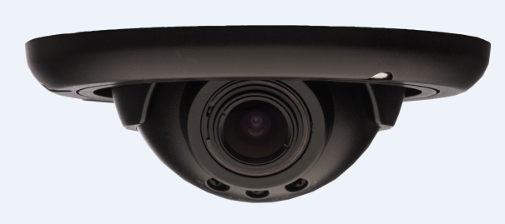
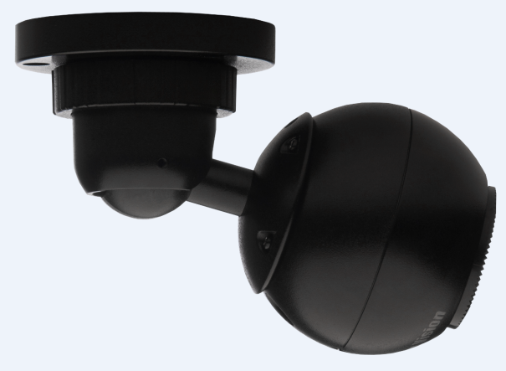
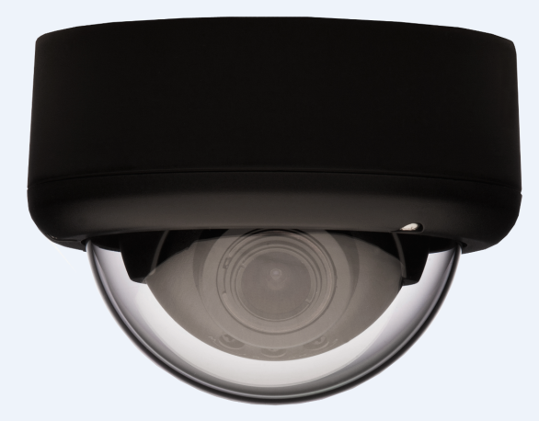
New Products in December
MegaBall™
3MP & 5MP
All-in-one indoor solution
Dome and In-ceiling configurations
Vari-Focal and fixed focal integrated lens options
Installer friendly design
ONVIF and PSIA conformant
1.3MP up to 5MP w/ WDR coming soon
Notes:
Company Profile Slide

Slide 13
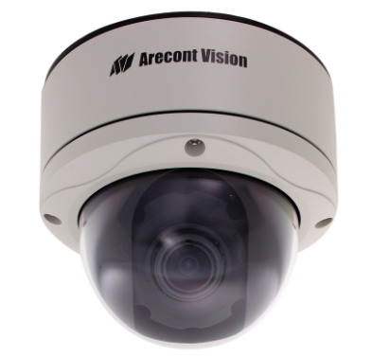
New Products in January
MegaDome® 2
WDR
All-in-one solution
WDR up to 100dB at full resolution
Remote Focus / Remote Zoom
P-Iris lens
1080p and 3MP resolutions
Weather and vandal resistant dome
Notes:
Company Profile Slide

Slide 14
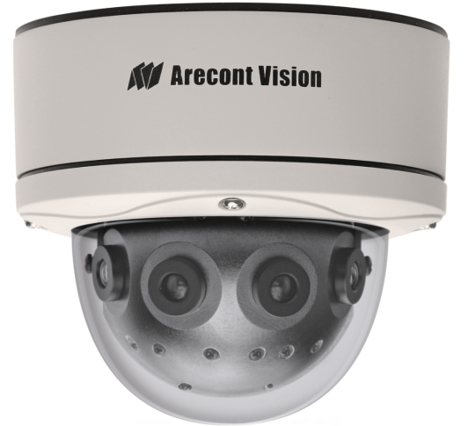
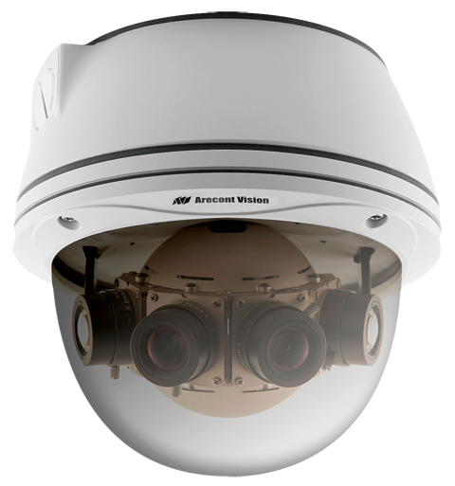
New Products in Q1 2013
40MP SurroundVideo
Panoramic Camera
12MP WDR SurroundVideo
Panoramic Camera
New Smaller Housing!
World’s 1st WDR
Panoramic Camera
Notes:
Company Profile Slide

Slide 15
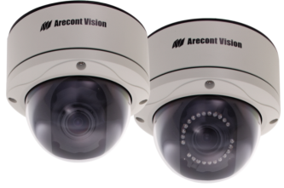
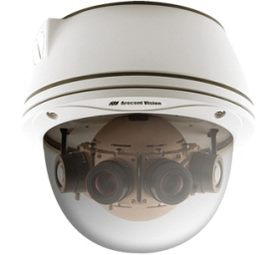
New Product Roadmap
2013
MegaDome 2
3MP & 5MP
MegaDome 2
10MP
MegaDome 2
1080p & 3MP WDR
MegaDome 2
1.3MP & 1080p
SurroundVideo
40MP
Q4 2012
PanoDynamic
12MP WDR
SurroundVideo
Q3 2012
MegaBall
1.3MP & 1080p
Compact WDR
2MP & 3MP
MegaBall
3MP & 5MP
MegaBall
1080p & 3MP WDR
Notes:
Company Profile Slide

Slide 16
Partner Introduction: Remote Monitoring
Geoffrey Stoliker
Regional Sales Manager
Notes:
Title Slide

Slide 17
The Customer Need for Remote Monitoring
100s of locations throughout the U.S.
Remote video monitoring for all locations.
Very low bandwidth from locations to C.S.
Megapixel quality.
Cost effective (ROI).

Slide 18
The Solution for Remote Monitoring
~16 Arecont Vision cameras per location.
Down sample the video between location and C.S.
Full resolution at each location.
3xLOGIC manages the video and the down sampling of the video to send to the C.S.
Presenter
Presenter’s Title
Presenter’s Phone Number
Presenter’s Email Address

Slide 19
Managed Services and Megapixel
Melissa Parsons
Director of Product Management
972-996-2858
Melissa.Parsons@Interfacesys.com
Notes:
Title Slide

Slide 20
3xLogic and Westec
Provides a Complete Solution
Compression Technology
POS and Video Analytics Options
IP Camera Compatibility
Support
Technical, Engineering and Customer

Slide 21
Arecont Vision and Westec
Security Market Focus
Provide a Full Assortment; Wide Selection
Dedication to Innovation
Resources and Support
Technical, Engineering and Customer

Slide 22
Thank You!
Melissa Parsons
Director of Product Management
972-996-2858
Melissa.Parsons@Interfacesys.com

Slide 23
Unleashing the Power of Megapixel
Brian Davis
Director of Sales, 3xLOGIC, Inc.
303.430.1969
brian@3xlogic.com
Notes:
Title Slide

Slide 24
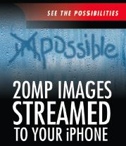
3xLOGIC Opens Doors – Closes Sales
Transcoding that enables megapixel and HD cameras to be used in analog or low bandwidth situations.

Slide 25
3xLOGIC Opens Doors – Closes Sales
RapidStream lets users stream 20MP or larger video to tablets or smart phones, even manage thousands of HD cameras from one central station.

Slide 26
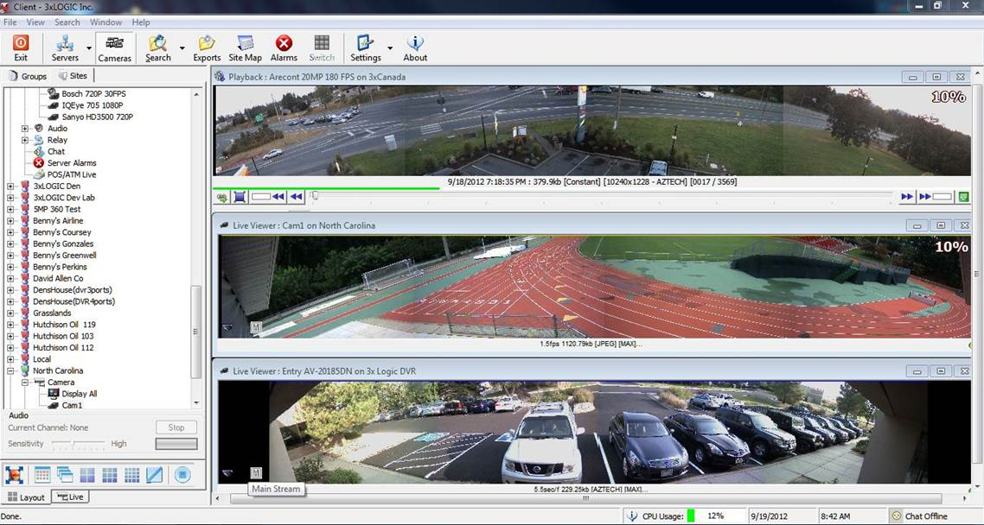
Allowing Arecont Vision to Shine
CUSTOMER SPECS: Download two minutes of video inside of three minutes
for 16 channels simultaneously!
Images on left are Arecont AV 20185 cameras.
Note the file sizes!
AZTECH PLAYBACK
RAW JEPG
AZTECH LIVE

Slide 27
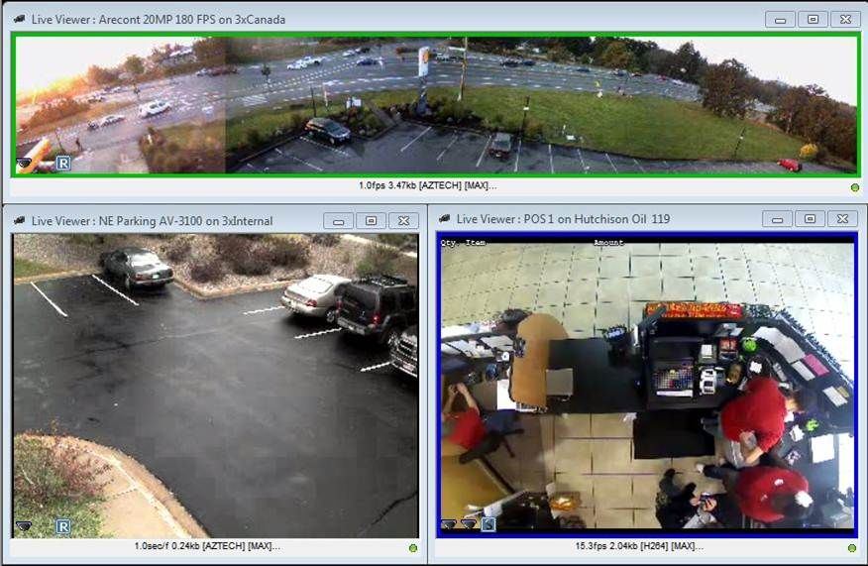
Making Megapixel Manageable
RapidStream enables high definition megapixel to be streamed at a fraction of the native file size.

Slide 28
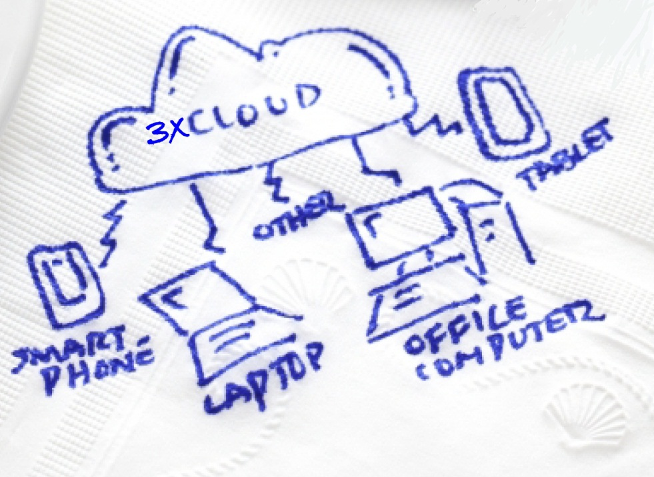
3xLOGIC Opens Doors – Closes Sales
3xCLOUD (a free web app from 3xLOGIC) lets you access one to a thousand cameras from any network device—anytime, anywhere.

Slide 29
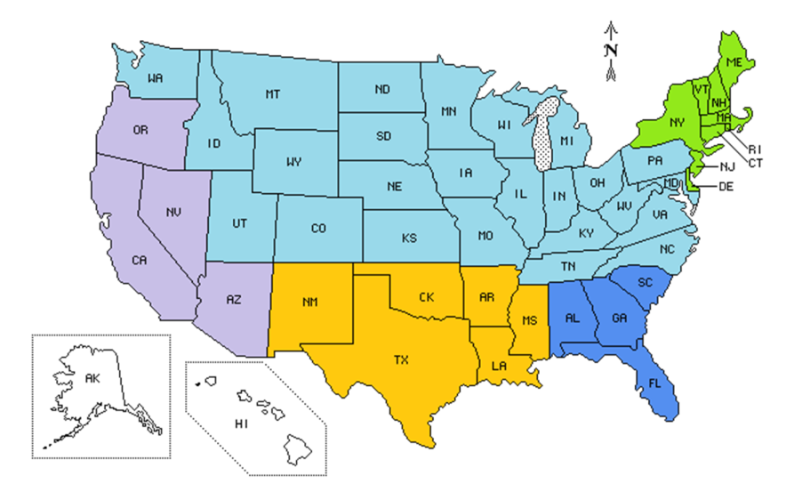
YOUR 3xLOGIC SALES TEAM – 303.430.1969 or 877.395.6442
Brian Davis – Director of Sales
Erron Spalsbury – Inside Sales Manager
Jim Hawver – National Account Sales Manager
Steve Bassett – Northeast Regional Sales
John Riccio – Western Regional Sales
Larry Odegard – Business Development
Mary Carter – Sales Administration
Brian
x1105
Erron
x1106
Jim
x1103
Steve
917.968.9483
John
704.877.0681
Larry
x1110
Mary
x1102

Slide 30
Let Us Help You Close Sales!
Brian Davis
Director of Sales, 3xLOGIC, Inc.
303.430.1969
brian@3xlogic.com

Slide 31
Tech Tips and Tricks
Ted Brahms
Director of Field Applications
Notes:
Title Slide

Slide 32
Lens Quality and Effects on Megapixel Imaging

Slide 33
Optical Quality is Important for Megapixel Imaging
Customers expect to get higher image quality and resolution with megapixel.
The lens is a critical accessory for success with megapixel surveillance.
Lens quality matters. With megapixel, one lens is not always equal to another.
There is a great difference between lenses used for standard resolution and megapixel.

Slide 34
Optical Quality and Megapixel Applications
With many applications, the ability to get the maximum possible detail out of an image is critical.
Reducing cameras and covering large areas is common in megapixel system design.
Image quality will be reduced with lower-grade lenses when digitally zooming regardless of the sensor resolution.

Slide 35
Optical Industry Challenge
The higher the pixel count of the sensor, the more important a high-quality lens becomes for optimal image quality.
There are no real industry standards specifying what makes a lens “megapixel.”
Lenses from two different manufacturers can vary greatly in specification.

Slide 36
Optical Industry Challenge
Specifications like ‘line pairs per millimeter’ (lp/mm) might provide some measure to compare but are not always disclosed.
Physical pixel size will vary for different resolution imagers as well.
Manufacturing high quality/ low aberration optics is more challenging for smaller C/CS format lenses.

Slide 37
Optical Variation Between Different Lenses
Two images taken from equivalently-rated megapixel lenses.

Slide 38
Choosing the Right Grade Lens
1.3MP
2MP
1080p
3MP
5MP
10MP
LENSx.x
OK to use
MPLx.x
Recommended
OK to use
UHDx.x
OK to use
Recommended
Arecont Vision offers three lens lines: LENS, MPL, UHD.
These lenses are rated based on in-house testing.
Arecont Vision also tests many top-tier manufacturers’ lenses.
Notes:
Get a quality lens
One way to be certain of getting a lens that meets the quality megapixel cameras require is to get it from Arecont Vision.
All lenses that Arecont Vision sells are tested against a number of parameters and only the best are offered.
Arecont Vision offers three lens lines that represent different quality and pricing: LENS, MPL, UHD.
The LENS line is low cost and good for 1.3 and 2MP.
Depending on the application this line could meet the needs of a 3MP or 1080p camera.
The MPL line is very cost competitive and has better quality than the LENS line.
MPL lenses can be used on 1.3, 2, 1080p and 3MP cameras as well as could be a good mid-range 5MP lens.
The UltraHD or UHD line is the flagship line specifically for the 10MP resolution.
For critical 5MP applications, this line is recommended.
Arecont Vision also conducts the same testing against top tier lens manufacturers’ “megapixel” lenses.
The list of lenses that have successfully passed these tests is supplied at the end of this document.

Slide 39
Choosing the Right Grade Lens
Lp/mm appropriate to the sensor resolution.
Sensor size vs. optical format.
Angle of View (critical for pixel density).
F# (critical for good depth of field).
IR correction (if using DN camera models).

Slide 40
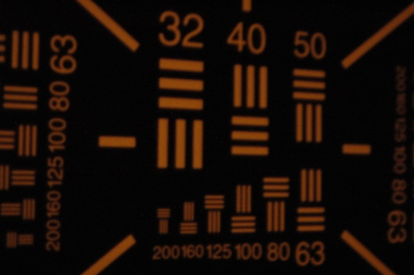
Choosing the Right Grade Lens
Line Pairs (lp)/ Camera Resolution:
10MP: 200 lp/mm
5MP: 151 lp/mm
1080p: 111 lp/mm
Vanishing resolution:
Bar pattern ( lp/mm)
Where the bars are visibly distinct

Slide 41
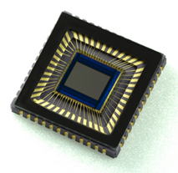
Choosing the Right Grade Lens
Image Sensor | Horizontal: H | Vertical: V | Diagonal: D
1” | 12.8mm | 9.6mm | 16mm
2/3” | 8.8mm | 6.6mm | 11mm
1/2" | 6.4mm | 4.8mm | 8.0mm
1/3” | 4.8mm | 3.6mm | 6.0mm
1/4" | 3.6mm | 2.7mm | 4.5mm
AV Camera | 1.3MP/ 2MP | 1.3MP/1080p | 3MP | 3MP/5MP | 10MP
Sensor Size | 1/2” | 1/2.7” | 1/2 | 1/2.5” | 1/2.3”

Slide 42
Choosing the Right Grade Lens
The angle of view will determine the size of the field-of-view that will be displayed by a specific lens on a specific resolution camera at a specified distance.

Slide 43
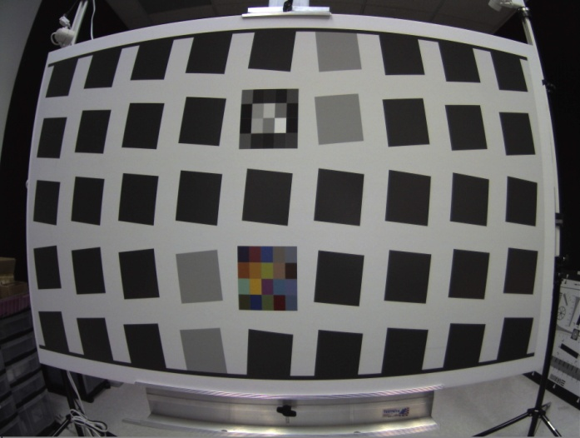
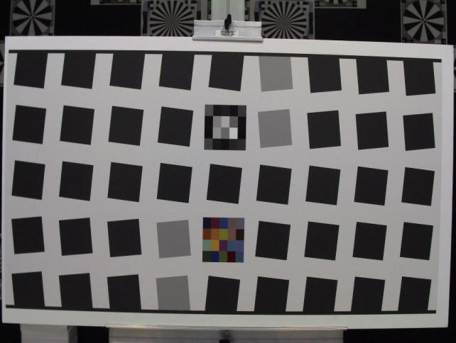
Choosing the Right Grade Lens
Very short focal lengths and the resulting wide angles of view can also introduce distortion of image edges.
Rectilinear lenses offered by some optics manufactures may help reduce this effect.
It is also important to remember a wider angle also lowers pixel density of the image compared to a narrower field-of-view on the same sensor.

Slide 44
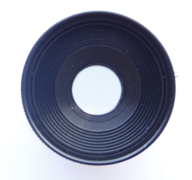
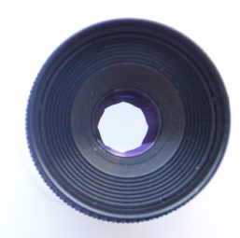
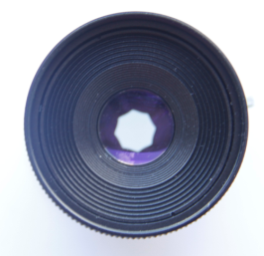
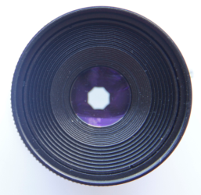
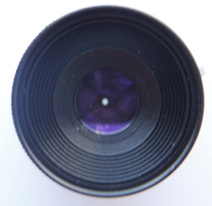
Choosing the Right Grade Lens
Note:
F# changes in Vari-focal lenses at Tele and Wide settings
The F No. indicates the aperture size of the lens. The smaller the value, the brighter the image produced by the lens.
As example - MPL4-10
@ - 4.5mm F1.6
@- 10mm F2.8
As sensor resolution gets higher pixel size gets smaller. Smaller F# will allow more light to reach the sensor. F# 1.2 – 1.4 will result in brighter less noisy images.
F1.4
F2
F2.8
F4
F22

Slide 45
Depth of Field
Shallow depth of field
Deep depth of field

Slide 46
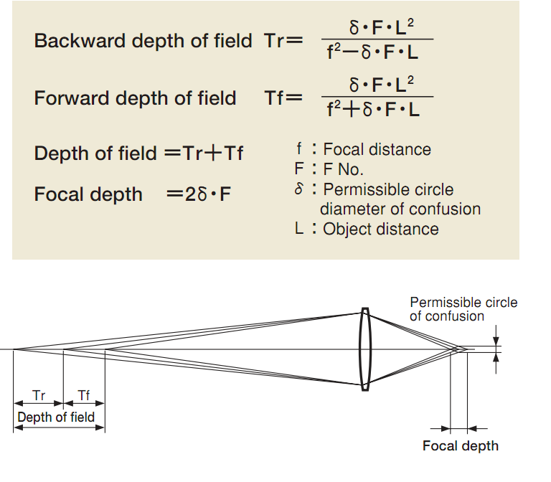
Trade-Off Between Depth of Field and F No.
How to get deeper Depth of Field:
1）Enlarge the F No.
2）Shorten focal length
3）Increase the distance to the object

Slide 47
Choosing the Right Grade Lens
Arecont Vision MegaDome®, MegaView® and SurroundVideo® series come with optimal lenses already installed.
We also carry a good selection of lenses for our box cameras: just select the appropriate grade for the resolution.
If you need longer focal length or a specialty lens not in our line up, contact us for a listing of third-party lenses tested by our product management team.

Slide 48
Q&A
Thank you!

